Slide 1
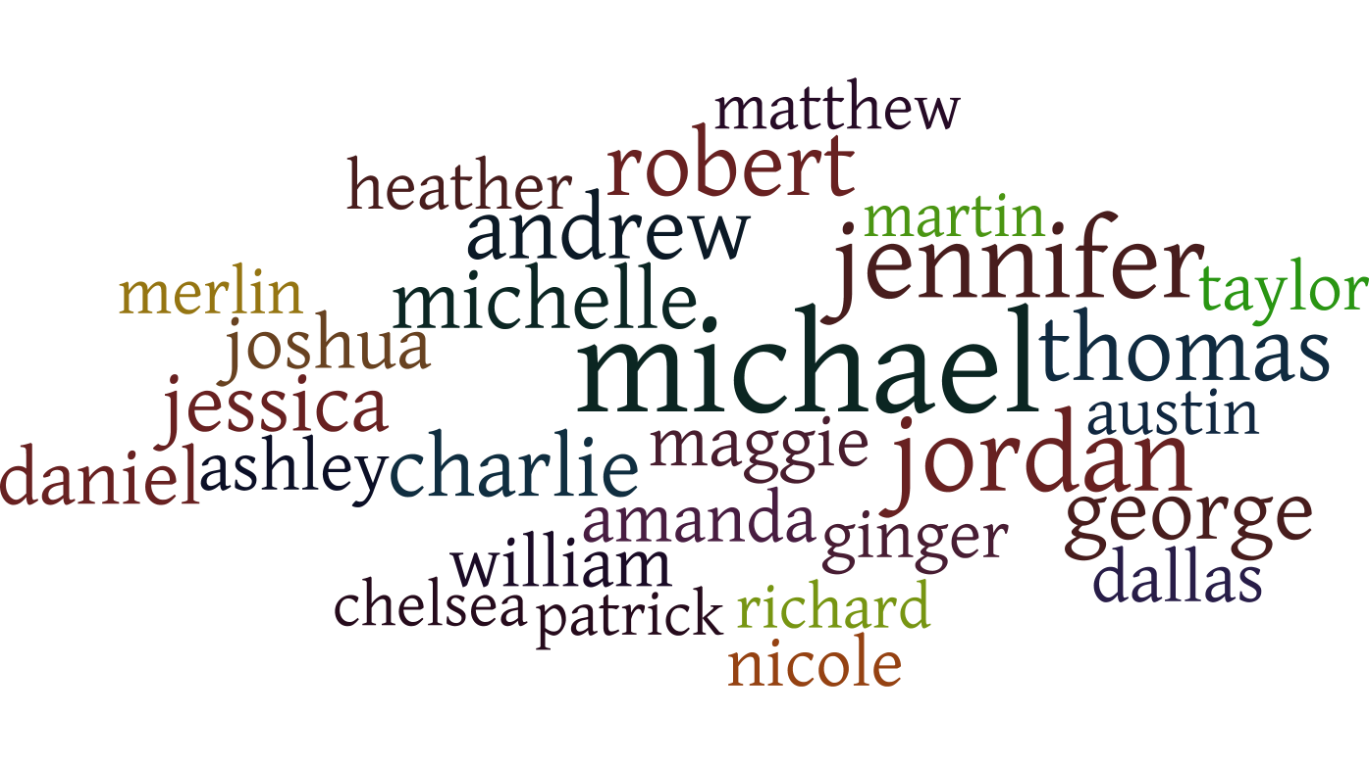
Wordle exercise Most Popular Names - 2013
Source: https://boingboing.net/2013/12/07/worst-passwords.html

Slide 2
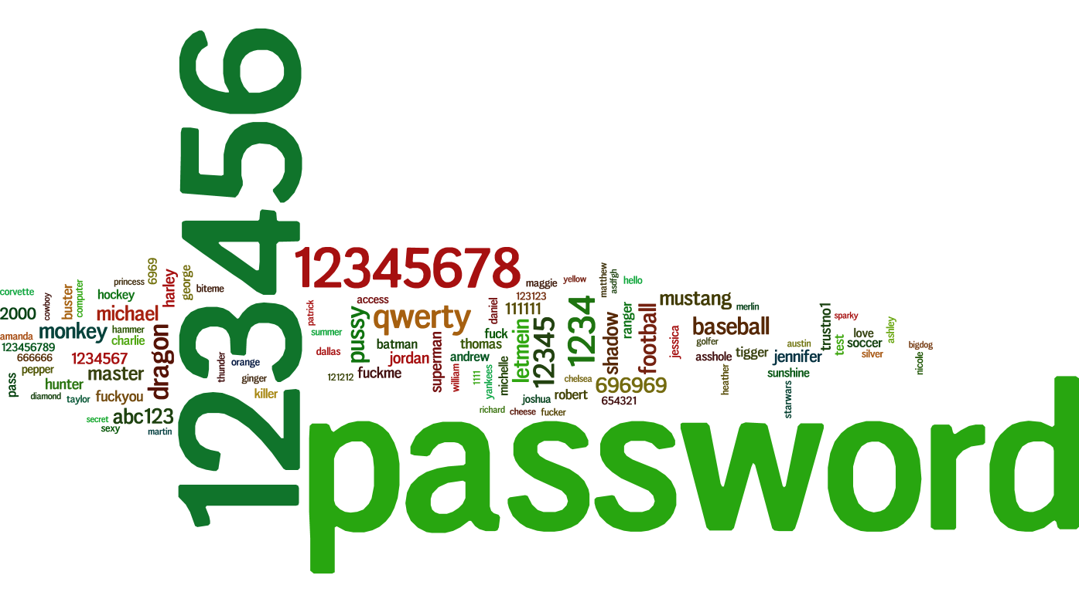
Wordle Exercise
Worst passwords
Source: https://boingboing.net/2013/12/07/worst-passwords.html

